Slide 1
Pricing Model for Big Mountain Resort

Slide 2
Problem Statements
Big Mountain is not capitalizing on its facilities as much as it could
The price on the ticket now is only based on the market average
Market average does not provide good sense of how important some facilities are

Slide 3
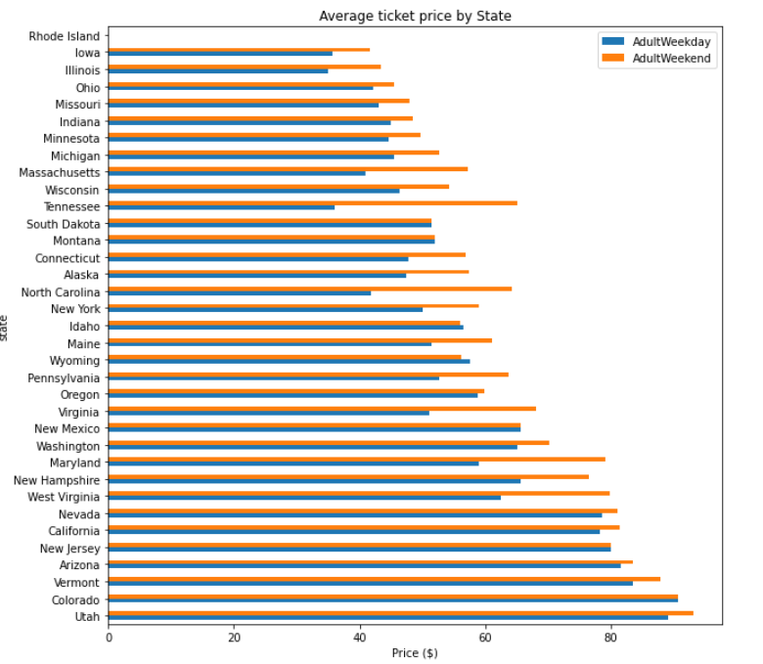
Recommendation and Key Findings
Big Mountain resort is in Montana
The price between weekday and weekend are almost identical in Montana

Slide 4
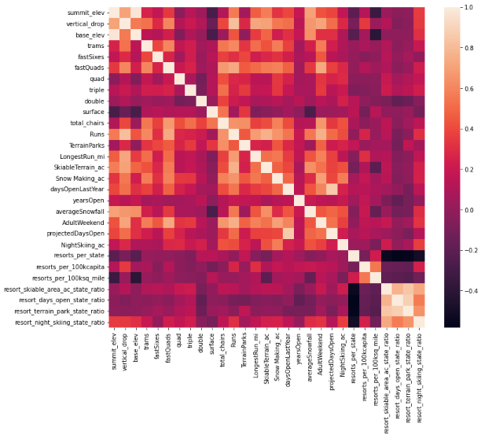
Modeling
The plot on the right depicts relationship of features
summit and base elevation are quite highly correlated
Features of importance:
vertical_drop
Snow Making_ac
total_chairs
fastQuads
Runs
LongestRun_mi
trams
SkiableTerrain_ac

Slide 5
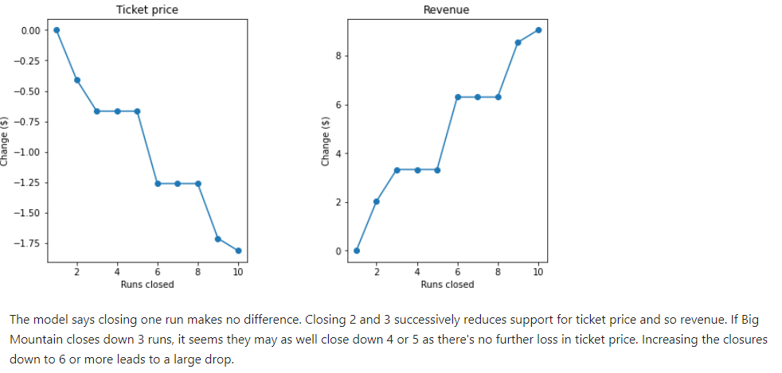
Modeling Continue
Random Forest and Linear Regression model were used to predict the price of ticket based on all the importance of features.
Comparing the 2 models, random forest provide slightly better result

Slide 6
Conclusion
Big Mountain current charge = $81
Big Mountain also has many features sitting at the higher end of the distribution comparing to other resorts in the states.
The model suggests charge = $95.87

